Slide 1
Lending Club Case Study
Contributor: Sukanya Karri

Slide 2
Problem statement:
You work for a consumer finance company that specializes in lending various types of loans to urban customers. When the company receives a loan application, the company has to decide for loan approval based on the applicant’s profile. The data given contains information about past loan applicants and whether they ‘defaulted’ or not.
Objective:
The aim is to understand the driving factors (or driver variables) behind loan default, i.e. the variables that are strong indicators of default, so that the client can utilize this knowledge for its portfolio and risk assessment.
Benefits of the case study:
Will understand the techniques involved in exploratory data analysis and the steps involved like cleaning, wrangling, and finding missing values.
Domain knowledge- Based on the data provided helps us to get an insight into its attributes, this EDA case study focuses on loans and defaulters, and risk analytics is a helpful concept to learn here
Understanding how data performs using various visualization charts

Slide 3
Steps involved: Data Analysis
Data Importing/understanding
Data Cleaning/Handling-Outliers/Fixing Missing Values/Finding Duplicates/Data Conversations
Identifying the existing relationship between data using univariate/segmented/Bivariate Variables using Data Visualization
Summarization of observations

Slide 4

Data Analysis Procedure in Brief
Import the given loan data set
Read the file in the CSV format in jupyter notebook
Understand the data and the various columns present
Search for the duplicated values
Identify the missing/Null values
Post the search and identification drop the duplicates and fix/remove the missing values
Search for the unique values and drop them if found not useful for the business objective
Do a little background research and figure out the attributes which will be useful for data analysis
Drop the columns that are not required for the analysis based on the project requirement and result expectation. For example: Zip Code, URL, etc..
Perform the data conversion and extract the necessary columns say month and year as and when required
Check for the empty spaces in categorical objects using the string function and remove them same.
Check for the outliers and remove the same
Perform the Univariate/Bivariate/Segmented univariate with different attributes using Data visualization techniques to understand the distribution of data and its performance compared to other elements.
Summarize the observations

Slide 5
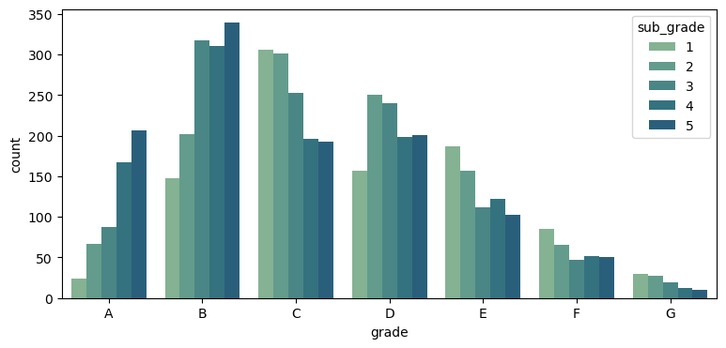
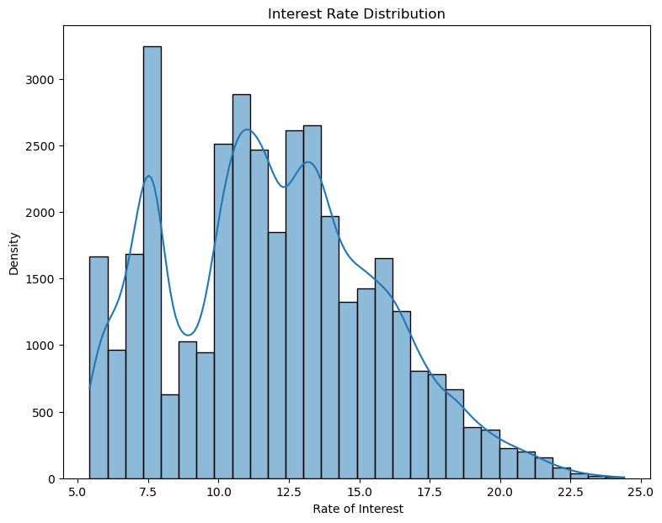
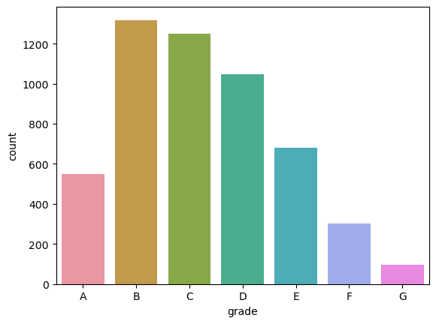
Distribution of Attributes at a Glance-1:
GRADE/SUB GRADE, Interest RATE
Most borrowers fall in the B and C categories of grades/subgrades
Interest Rate is high at 7.5 and has a sharp decline at 10 and most of the people opting for ROI falls in 10 to 14

Slide 6
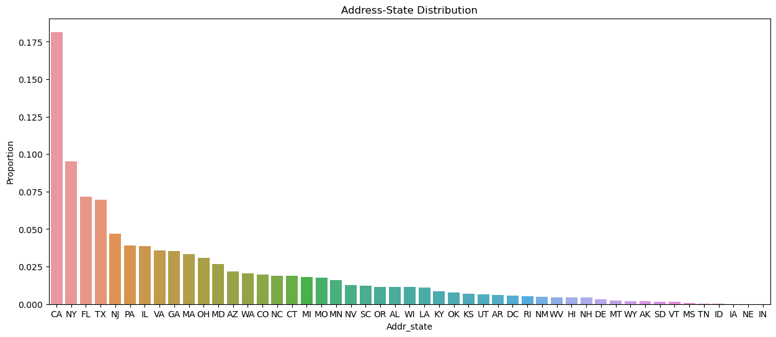
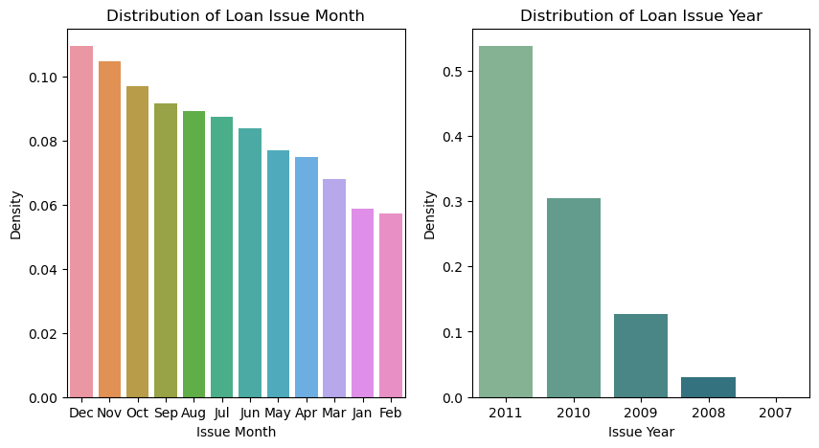
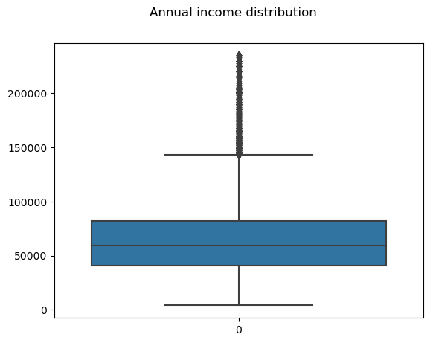
Distribution of Attributes at a Glance-2:
Address STATE,iSSUE MONTH/YEAR, ANNUAL INC
The majority of the people who opt for loans are from cities like California, New yok and Texas
Most of people took loans in December and in 2011 the highest records of loans for Dec month were given the most and the loans taken by people had a huge rise in 2011 compared to the previous years
Most of the people opting for loan has low annual income

Slide 7
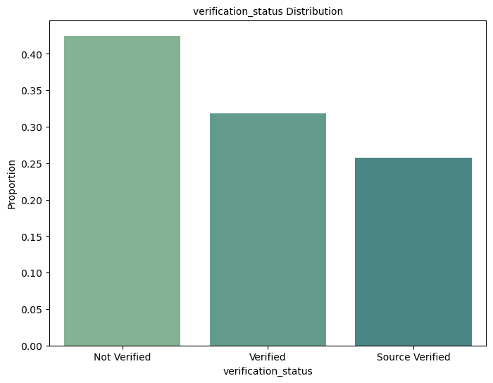
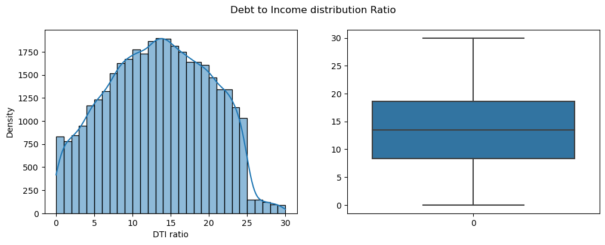
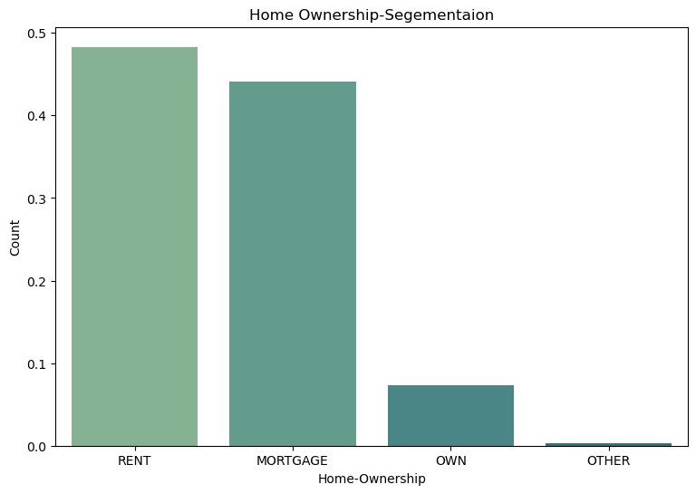
Distribution of Attributes at a Glance-3: DTI, Home Ownership &Verification Status
Most of the loans were given without proper verification of the loantaker
Majority of the loan takers has high DTI Ratio which is a risk factor
Home Ownership distribution is major in the rental house segment

Slide 8
COMPARISONS (V/S)

Slide 9
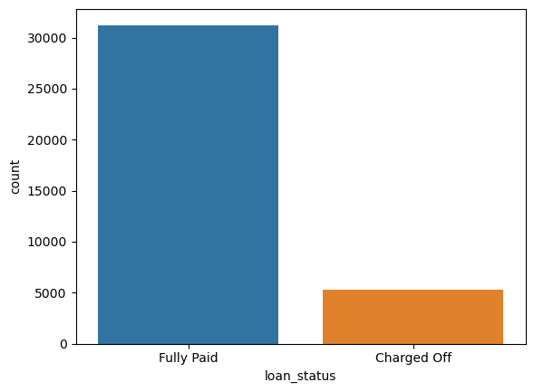
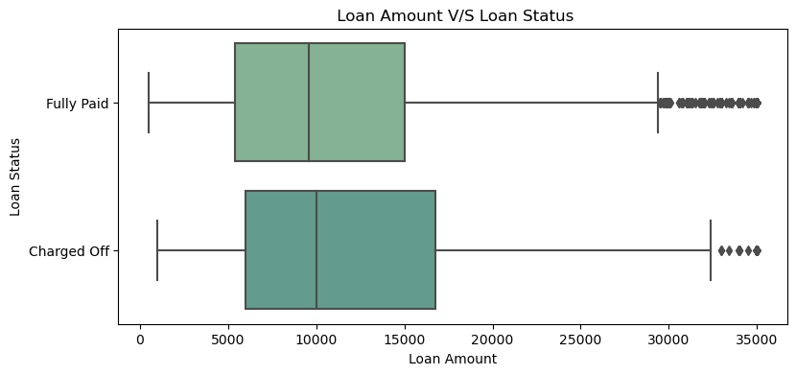
Loan StATUS VS LOAN AMOUNT:
Value of Charged off loans is less compared to Fully Paid loans
Median and 1st quartile are almost the same but the majority of the people falling in the 3rd quartile which is 15k+ seem to be the largest defaulters

Slide 10
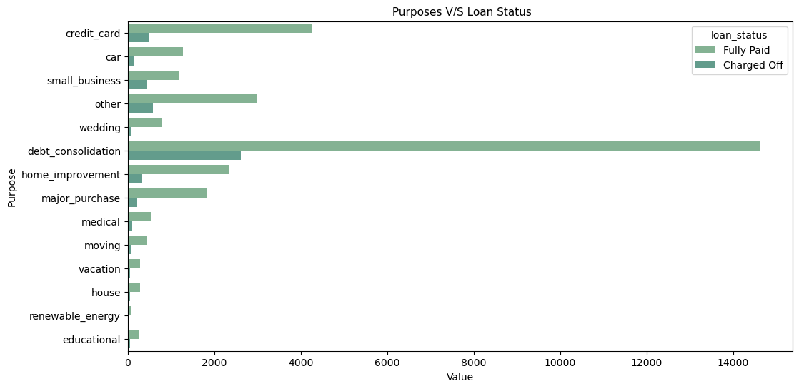
Purpose: Data Consolidation
Debt consolidation stands as the major purpose for loan defaulters

Slide 11
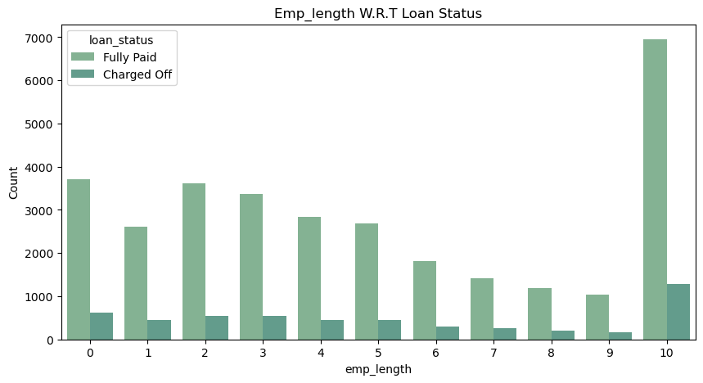
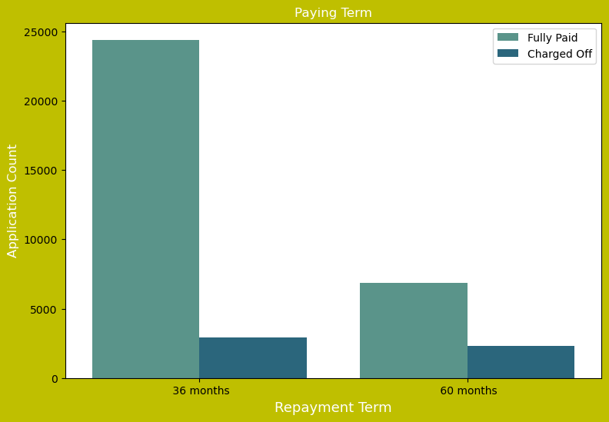
Loan Status
Employee Length
The status of charged off loans seems to be higher for employees more than 10 years pointing at chances of default
Term
36 Months Charged off percentage is high compared to 60 Months with respect to fully paid loans

Slide 12
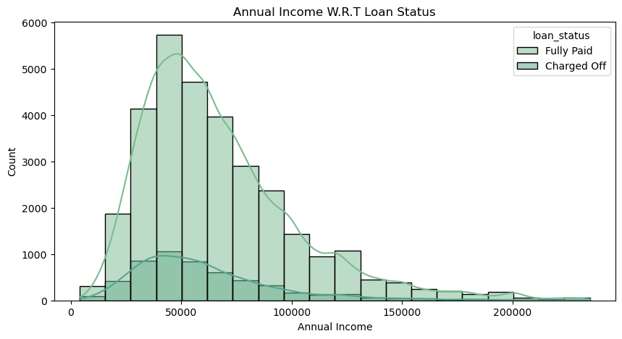
Loan Status
Annual Income
Majority of the people who may default fall in the range of 50000 to 70000

Slide 13
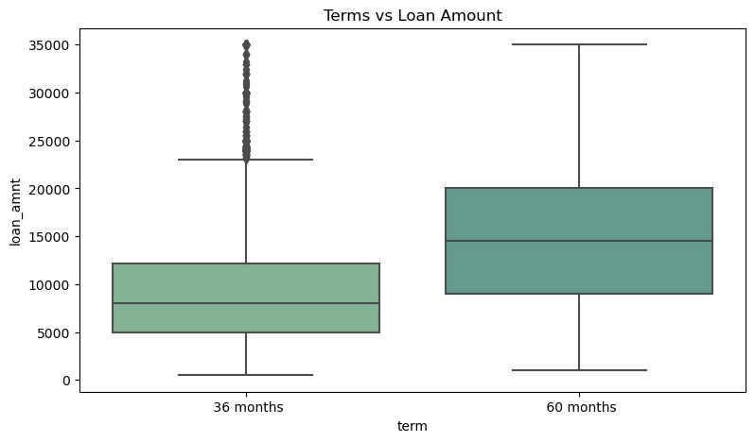
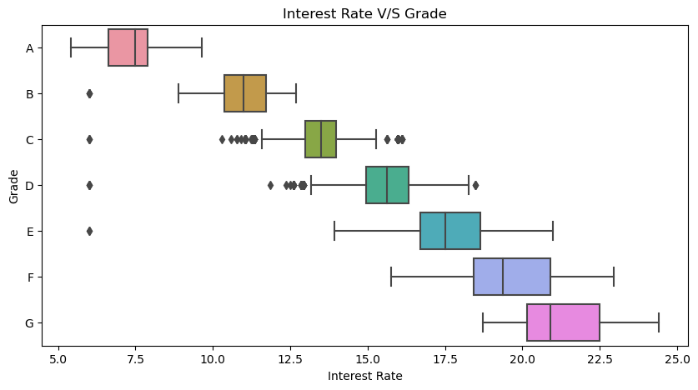
Loan Amount
Term
Grade
Plot 1: Defaulters seem to be more for the 3rd quartile of 36 months and 1st quartile of 60 months and the loan amount that can defaulted in both scenarios falls in the range of 10k-16k
Plot 2: The higher the rate of interest the lesser the grade

Slide 14
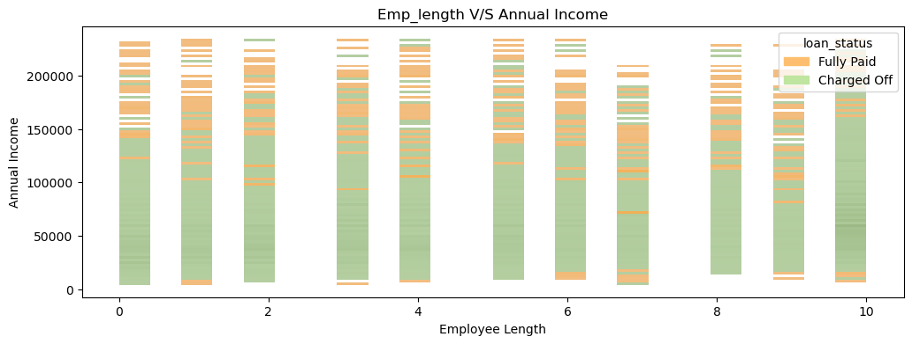
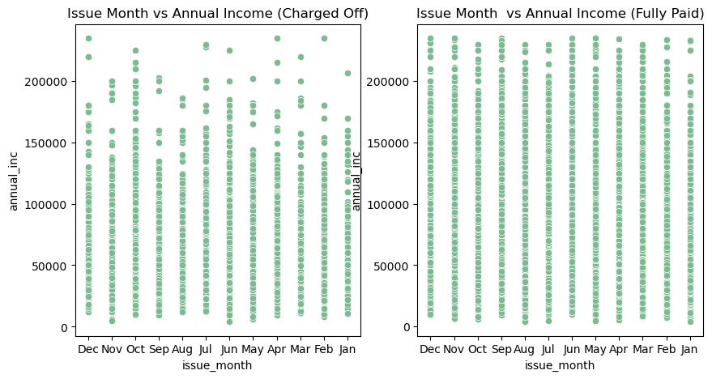
ANNAUL INCOME
Employee Length
Issue Month
October month irrespective of annual income ranges indicates a large chances for defaulting
There are chances of more defaulters in the 10+year range, however when considering the annual income range of defaulters is more in the range of 10k to 15k irrespective of length of employment.

Slide 15
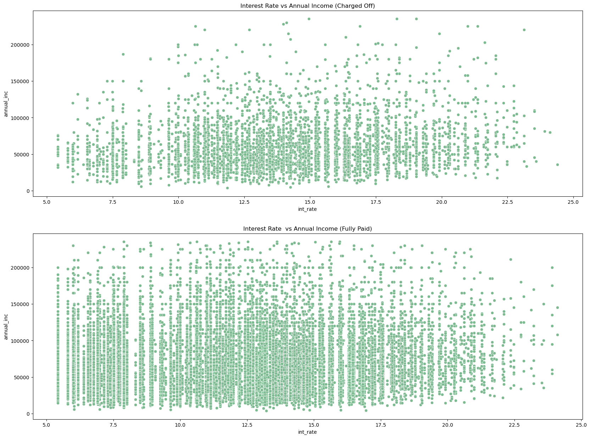
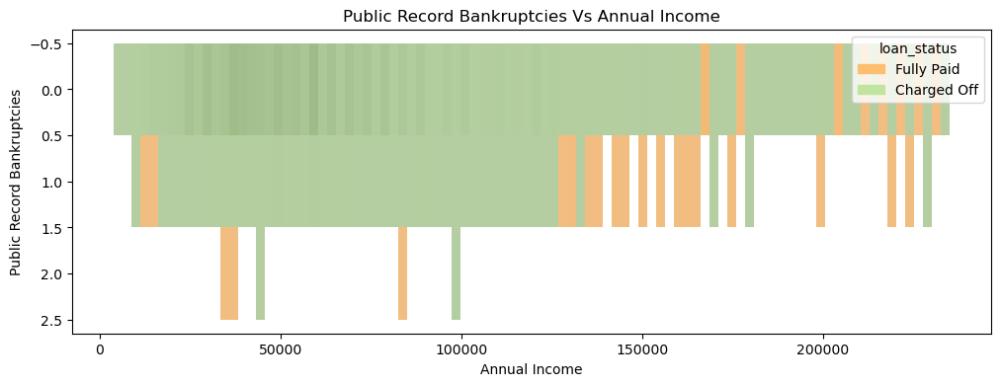
ANNUAL INCOME
Interest Rate
Public record Bankruptcies
Bankruptcies seem to be higher for charged-off loan status inclining more in the income range of 10-13k
From the charged-off plot we can say that maximum defaulters fall in the annual income range <10k with an interest rate opted for 11 to 16 percent Not much info can me made from fully paid

Slide 16
Summary:
Observations:
Major driving factors (or driver variables) behind loan default from the observations made are as follows:
Employment Length – observed that consumers who have more than 10 years of experience in loans are charged off most.
Grades/Sub-Grades- The analysis tells that increasing rates increase the default rate and persons with lower grades seem to default most.
Verification Status-Most of the loans were provided without verification
Annual income- Range of 10k-16k Income has high chances of defaulters
Term- Preference of loan term plays a role in loan defaulting
Purpose- From observation, it was found that purpose plays an important role in loan defaulting

